Slide 1


CHAPTER 2. MAPREDUCE AND THE NEW SOFTWARE STACK
2.3 Algorithms Using MapReduce
Chonnam National University
Dept of Artificial Intelligence Convergence
Distributed Networks and Systems Laboratory
Uğur Erçelik(248185)
SimVP: Towards Simple yet Powerful Spatiotemporal Predictive Learning
Tan, Cheng, et al. "Simvp: Towards simple yet powerful spatiotemporal predictive learning." arXiv preprint arXiv:2211.12509 (2022).

Slide 2
Index
Data Mining Basics
Map Reduce And BigData

Slide 3
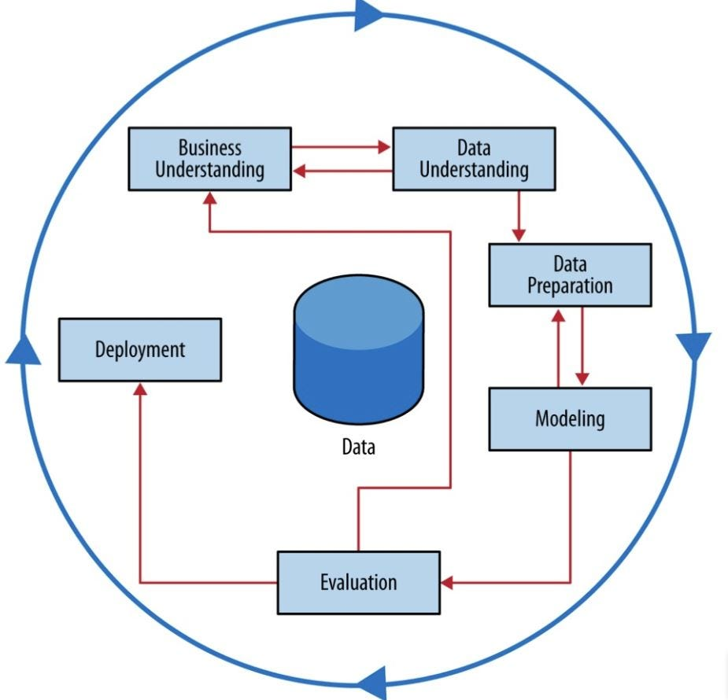
1. Data Mining Basics
What is Data Mining ?
Data mining is the use of machine learning and statistical analysis to uncover patterns and other valuable information from large data sets.
The process of sorting through large data sets to identify patterns and relationships that can help solve business problems through data analysis

Slide 4
1. Data Mining Basics
Bonferroni’s Principles
Bonferroni’s Principle in data mining is a guideline that helps prevent drawing false conclusions from data by cautioning against overzealous searches for patterns. It suggests that if you search for too many patterns in a large dataset, you're likely to find some patterns purely by random chance, even if they aren't meaningful. Essentially, it warns against mistaking coincidences or random occurrences for significant results.
Key Aspects:
Random Patterns: In large datasets, even random data will occasionally show patterns that seem statistically significant, but they are just artifacts of chance.
Statistical Artifact: Bonferroni’s Principle helps recognize when an observed pattern is likely a statistical artifact (false positive), meaning it has no real-world relevance.
Multiple Testing Problem: The more hypotheses or patterns you test in your data, the higher the likelihood that some will falsely appear significant just by chance.

Slide 5
1. Data Mining Basics
Modeling in Data Mining
The goal of modeling is to extract valuable insights, make predictions, or support decision-making based on the data. There are different approaches to modeling in data mining, each suitable for specific types of problems or data structures.
Statistical Modeling
Statistical modeling is one of the oldest forms of modeling and involves using statistical techniques to summarize the underlying data distribution. It assumes that the data comes from a specific statistical distribution, such as normal (Gaussian), Poisson, or exponential distributions.
Machine Learning-Based Modeling
Machine learning (ML) is a data-driven approach where models "learn" from data. ML models are often used in data mining to detect complex patterns and make predictions based on previously unseen data.
Supervised and Unsupervised Learning types of ML Models
Key Concepts in ML Modeling:
Training and Testing: Data is divided into training and testing sets. The model is trained on the training set and validated using the testing set to check its accuracy.
Overfitting: A common problem where the model performs well on training data but poorly on unseen data because it has become too complex.

Slide 6
1. Data Mining Basics
Computational Modeling
A model is viewed as the answer to a computational query. The focus here is on designing algorithms that efficiently solve the problem rather than fitting statistical or machine learning models.
Example: A model could be an algorithm that counts the frequency of different words in a text document. The result is a summary of the text, such as the most frequently occurring words.
Key Techniques:
Locality-Sensitive Hashing (LSH): A method for efficiently finding similar items in large datasets.
Stream Mining: Algorithms designed to handle continuous streams of data, where the data is processed in real-time without storing the entire dataset.
Hybrid Approaches
Some models in data mining combine elements of both statistical and machine learning techniques. For example, a model might start with a statistical summary of the data (mean, variance) and then use machine learning techniques to make more sophisticated predictions or classifications.
Important Tools:
TF-IDF (Term Frequency-Inverse Document Frequency): Measures word importance in documents based on how frequently words appear in a specific document compared to the entire dataset.

Slide 7
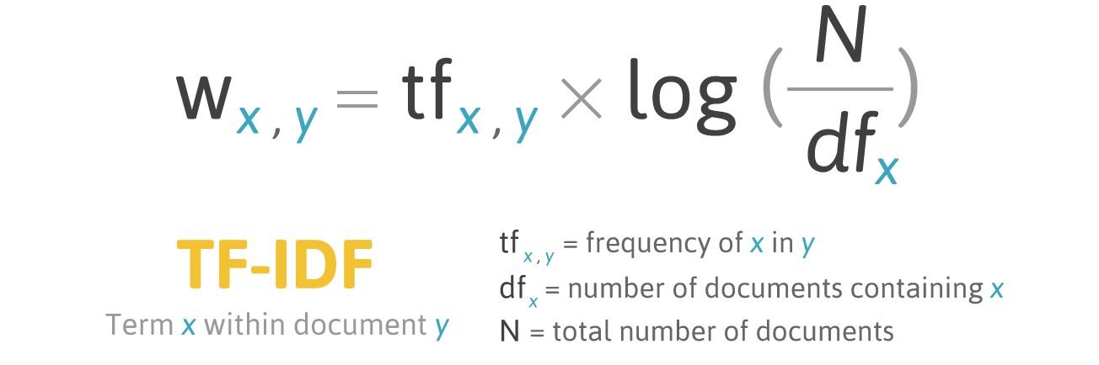
1. Data Mining Basics

Slide 8
2. MapReduce and Big Data
MapReduce is a programming model and framework for processing and generating large datasets with a distributed algorithm on a cluster of computers. It’s particularly useful for tasks that involve handling "big data," where datasets are too large to process on a single machine.
Map Function:
The Map step takes a dataset, applies a function to each piece of data, and generates intermediate key-value pairs.
Shuffle and Sort:
After the map step, the system groups all key-value pairs by their keys. This process is called shuffle and sort. It ensures that all values associated with the same key are grouped together before the reduce phase.
Reduce Function:
The Reduce step aggregates the results from the map step. It processes each key and its associated values to produce a final output.
How MapReduce Works:
The input data is split into chunks and distributed across different nodes in a distributed file system (like Hadoop Distributed File System or HDFS).
Map tasks are assigned to different worker nodes, where each node applies the Map function to its portion of the data.
The results of the Map tasks are shuffled and sorted so that all related data is brought together for the same key.
Reduce tasks are then applied to aggregate the results into a final output, which is written back to the distributed file system

Slide 9
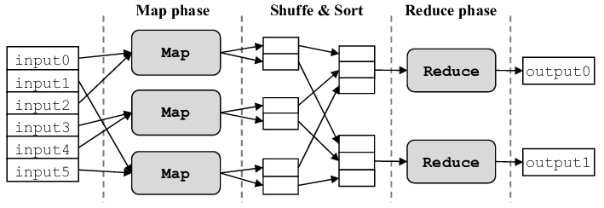
2. MapReduce and Big Data
MapReduce Workflow:
In a typical MapReduce workflow, tasks are executed in multiple stages:
Data Preprocessing: The data might first be cleaned or transformed using an initial MapReduce job.
Analysis or Processing: Once the data is prepared, another MapReduce job might be applied to perform the main analysis, such as aggregating data or calculating metrics.
Post-processing: After analysis, additional jobs might be used to filter, sort, or format the output.

Slide 10
2. MapReduce and Big Data
Several algorithms can be effectively implemented using the MapReduce model to handle large-scale data.
Matrix-Vector Multiplication
This is a common operation in scientific computing, often used in algorithms like PageRank (Google's ranking algorithm for webpages). The goal is to multiply a matrix with a vector using MapReduce.
Given a matrix M of size n × n and a vector v of length n, the product x = Mv is calculated, where x[i] = Σ (M[i, j] * v[j])
Map Function
Input: A matrix element (i, j, M[i,j]) and a vector element v[j].
Output: Emit key-value pairs where the key is i (the row index of the matrix) and the value is M[i,j] * v[j] (the product of the matrix element and the corresponding vector element).
Example: If M[i,j] = 2 and v[j] = 3, the output would be (i, 6).
Reduce Function:
Input: Key i (row index) and a list of values (products of matrix elements and vector elements).
Output: Sum the values for each row i to compute the corresponding element of the result vector x[i].
Example: For row i = 1, if the list of values is [6, 8, 4], the output would be (1, 18).

Slide 11
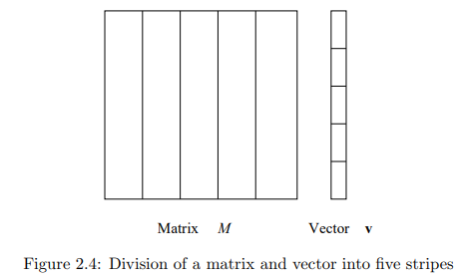
2. MapReduce and Big Data
If the vector v cannot fit into the main memory during matrix-vector multiplication in MapReduce, we need to partition both the matrix and the vector to ensure that each chunk of the vector can be processed by a Map task without exceeding memory limits.
1.Partition the Matrix and the Vector:
Matrix Partitioning: The matrix M is split into vertical stripes. For example, if the matrix has n columns, and the vector is too large to fit in memory, you can divide the matrix into k vertical stripes, where each stripe consists of a subset of the columns.
Vector Partitioning: The vector v is split into horizontal stripes that correspond to the stripes of the matrix. Each stripe of the vector contains the entries needed for one of the matrix stripes.
2.Map Function:
Each Map task processes a chunk (stripe) of the matrix and the corresponding stripe of the vector.
The Map function reads the appropriate stripe of v into memory.
It computes partial products for the matrix elements and their corresponding vector elements, generating key-value pairs (i, partial_sum) for each row i of the matrix.
Example:For each element M[i, j] in the matrix stripe, the Map task multiplies it with the corresponding vector element v[j] from the vector stripe and produces an intermediate result (i, M[i,j] * v[j]).

Slide 12
2. MapReduce and Big Data
3.Reduce Function:
The Reduce function gathers all the partial sums for each row i from the different stripes and sums them up to produce the final result.
For each row i, the Reduce function receives a list of partial sums (one from each Map task) and computes the total sum to produce the final result for x[i].
Advantages of Partitioning:
Memory Efficiency: By breaking the vector into smaller chunks, each Map task only processes a portion of the vector that fits into memory.
Parallelism: The matrix and vector partitions are processed in parallel across different Map tasks, making the approach scalable to large matrices and vectors.
Flexibility: This approach works well for large-scale matrix-vector multiplications, especially when dealing with extremely large datasets (e.g., PageRank computations for web graphs).

Slide 13
2. MapReduce and Big Data
Relational-Algebra Operations
MapReduce can be used to perform traditional relational database operations like Selection, Projection, Union, Intersection, Difference, and Join.
Natural Join: R ⊲⊳ S
Given two relations R(A,B) and S(B,C), the goal is to find tuples (A, B, C) where the B values in R and S match.
Map Function:
Input: Tuples from relations R and S.
Output: For each tuple in R, emit the key as B and the value as (R, A). For each tuple in S, emit the key as B and the value as (S, C).
Example: From (A=1, B=2) in R, emit (2, (R, 1)). From (B=2, C=3) in S, emit (2, (S, 3)).
Reduce Function:
Input: Key B and a list of values from R and S.
Output: For each pair of values (R, A) and (S, C) with the same key B, emit the tuple (A, B, C).
Example: For key B=2, with values [(R, 1), (S, 3)], the output would be (1, 2, 3).

Slide 14
2. MapReduce and Big Data
Computing Selections by MapReduce
Selection in relational databases is an operation that retrieves rows (or tuples) from a table that meet a certain condition or predicate. In MapReduce, selection can implemented operation to filter data by applying the condition during the Map phase. This operation can be parallelized efficiently using the MapReduce framework, even for large datasets.
Selection in relational databases is an operation that retrieves rows (or tuples) from a table that meet a certain condition or predicate. In MapReduce, we can implement the selection operation to filter data by applying the condition during the Map phase. This operation can be parallelized efficiently using the MapReduce framework, even for large datasets.
Selection Operation Overview:
The selection operation in relational algebra is denoted as: σC(R) Where:
C is a condition applied to each tuple.
R is a relation (table).
The result of σC(R) is the set of tuples from R that satisfy condition C.
MapReduce Implementation of Selection:
1. Map Function:
In the Map phase, the function processes each tuple (row) from the dataset. The Map function checks if the tuple satisfies the condition C and only emits the tuple if it passes the condition.
Input: A tuple from the relation R.
Output: A key-value pair where both the key and value are the tuple itself (or part of it) if it satisfies condition C.

Slide 15
2. MapReduce and Big Data
Computing Selections by MapReduce
2. Reduce Function:
The Reduce function in this case is very simple (and often unnecessary). Since the Map function already filters the data and emits only the desired tuples, the Reduce function can simply pass through the data it receives. It is an identity function, which outputs the key-value pairs without any modification.
Input: Key-value pairs (both the key and value are the tuple itself).
Output: The same key-value pair, essentially outputting the filtered tuples.
Advantages of Using MapReduce for Selection:
Scalability: MapReduce allows the selection operation to be performed efficiently on large datasets by distributing the workload across multiple nodes.
Parallelization: Each node in the cluster can process a different portion of the data in parallel, applying the selection condition independently.
Fault Tolerance: MapReduce ensures that even if a node fails, the job can be restarted without losing progress.

Slide 16
2. MapReduce and Big Data
Computing Projections by MapReduce
Projection in relational databases is an operation that selects specific columns (attributes) from a table, eliminating the other columns. In MapReduce, computing a projection involves extracting only the desired attributes (columns) from each row in the dataset and ensuring that duplicate rows are eliminated.
Projection Operation Overview:
In relational algebra, the projection operation is denoted as: πs(R)Where:
S is the set of attributes (columns) to be retained.
R is the relation (table).
The result of πS(R) is a relation containing only the columns in S, with duplicate rows removed.
MapReduce Implementation of Projection:
1. Map Function:
In the Map phase, the function processes each tuple (row) from the dataset and extracts only the specified attributes S. It emits the extracted tuple as both the key and the value.
Input: A tuple from the relation R.
Output: A key-value pair where the key is the tuple with only the selected attributes, and the value is the same.
2. Reduce Function:
The Reduce phase is used to eliminate duplicates. After the Map phase, identical projected tuples may appear more than once. The Reduce function groups the tuples by their key (the projected tuple) and emits only one copy of each key.
Input: Key (the projected tuple) and a list of values.
Output: The unique key (projected tuple), ensuring that duplicates are removed.

Slide 17
2. MapReduce and Big Data
Union , Intersection , and Difference by MapReduce
1. Union by MapReduce
The union operation combines all tuples from two relations R and S that have the same schema. In the union operation, duplicates are removed so that each tuple appears only once in the result.
Map Function:
Input: A tuple from either relation R or S.
Output: Emit the tuple as both the key and the value.
Reduce Function:
Input: A key (the tuple) and a list of values (which will either have one or two occurrences of the tuple, depending on whether it appears in both R and S).
Output: Emit the tuple once, regardless of how many times it appears
Map Phase:
For 𝑅, emit: ((1, "Alice"), (1, "Alice")), ((2, "Bob"), (2, "Bob"))
For 𝑆, emit: ((2, "Bob"), (2, "Bob")), ((3, "Charlie"), (3, "Charlie"))
Reduce Phase:
For ((1, "Alice"), [tuple]), output (1, "Alice")
For ((2, "Bob"), [tuple, tuple]), output (2, "Bob")
For ((3, "Charlie"), [tuple]), output (3, "Charlie")
Final Output (Union):{(1,"𝐴𝑙𝑖𝑐𝑒"),(2,"𝐵𝑜𝑏"),(3,"𝐶ℎ𝑎𝑟𝑙𝑖𝑒")}

Slide 18
2. MapReduce and Big Data
Union , Intersection , and Difference by MapReduce
2. Intersection by MapReduce
The intersection operation retrieves only the tuples that appear in both relations 𝑅 and 𝑆.
Map Function:
Input: A tuple from either relation 𝑅 or 𝑆.
Output: Emit the tuple as the key and the relation identifier (either 𝑅 or 𝑆) as the value.
This allows the Reduce function to identify whether the tuple exists in both relations.
Example: If a tuple is (a, b) and it comes from 𝑅, emit ((a, b), "R").
Reduce Function:
Input: A key (the tuple) and a list of values (either ["R"], ["S"], or ["R", "S"]).
Output: Emit the tuple only if both 𝑅 and 𝑆 appear in the value list (i.e., if the tuple appears in both relations).
Example: If the key (a, b) has values ["R", "S"], emit (a, b).
𝑅={(1,"𝐴𝑙𝑖𝑐𝑒"),(2,"𝐵𝑜𝑏")}
𝑆={(2,"𝐵𝑜𝑏"),(3,"𝐶ℎ𝑎𝑟𝑙𝑖𝑒")}
Map Phase:
For 𝑅, emit: ((1, "Alice"), "R"), ((2, "Bob"), "R")
For 𝑆, emit: ((2, "Bob"), "S"), ((3, "Charlie"), "S")
Reduce Phase:
For ((1, "Alice"), ["R"]), no output
For ((2, "Bob"), ["R", "S"]), output (2, "Bob")
For ((3, "Charlie"), ["S"]), no output
Final Output (Intersection):{(2,"𝐵𝑜𝑏")}

Slide 19
2. MapReduce and Big Data
Union , Intersection , and Difference by MapReduce
3. Difference by MapReduce
The difference operation retrieves the tuples that appear in relation 𝑅 but not in relation 𝑆.
In relational algebra, this is denoted as 𝑅−𝑆.
Map Function:
Input: A tuple from either relation 𝑅 or 𝑆.
Output: Emit the tuple as the key and the relation identifier (R or S) as the value.
Example: If a tuple is (a, b) and it comes from 𝑅, emit ((a, b), "R").
Reduce Function:
Input: A key (the tuple) and a list of values (either ["R"], ["S"], or ["R", "S"]).
Output: Emit the tuple only if it appears in 𝑅 but not in 𝑆.
Example: If the key (a, b) has values ["R"], emit (a, b).
𝑅={(1,"𝐴𝑙𝑖𝑐𝑒"),(2,"𝐵𝑜𝑏")}
𝑆={(2,"𝐵𝑜𝑏"),(3,"𝐶ℎ𝑎𝑟𝑙𝑖𝑒")}
Map Phase:
For 𝑅, emit: ((1, "Alice"), "R"), ((2, "Bob"), "R")
For 𝑆, emit: ((2, "Bob"), "S"), ((3, "Charlie"), "S")
Reduce Phase:For ((1, "Alice"), ["R"]), output (1, "Alice")
For ((2, "Bob"), ["R", "S"]), no output
For ((3, "Charlie"), ["S"]), no output
Final Output (Difference 𝑅−𝑆):{(1,"𝐴𝑙𝑖𝑐𝑒")}

Slide 20
2. MapReduce and Big Data
Computing Natural Join by MapReduce
The Natural Join operation in relational databases combines two relations by matching tuples based on common attributes. In the MapReduce framework, this operation can be efficiently parallelized, allowing for large-scale processing of the join operation.
Natural Join Overview:
Given two relations R(A,B) and S(B,C) a Natural Join retrieves tuples where the common attribute B matches in both relations, and it returns a new relation with attributes (A,B,C).
The natural join can be expressed as:
R(A,B)⋈ S(B,C)
This produces a result where R.B=S.B and outputs the combined tuples (A,B,C).
Example:Given:Relation 𝑅(𝐴,𝐵)={(1,10),(2,20)} Relation 𝑆(𝐵,𝐶)={(10,"𝑋"),(20,"𝑌")}
Map Output:For 𝑅(𝐴,𝐵) Emit (10, ("R", 1)), (20, ("R", 2))For 𝑆(𝐵,𝐶) Emit (10, ("S", "X")), (20, ("S", "Y"))
MapReduce Implementation of Natural Join:
1. Map Function:
The Map function processes tuples from both relations, emitting the join attribute B as the key, and the other attributes as the value.
Input: Tuples from relations R(A,B) and S(B,C)
Output: For each tuple in R, emit a key-value pair where the key is B, and the value is (R,A).For each tuple in S, emit a key-value pair where the key is B, and the value is (S,C).

Slide 21
2. MapReduce and Big Data
Computing Natural Join by MapReduce
2. Shuffle and Sort Phase:
The MapReduce framework automatically shuffles and sorts the intermediate key-value pairs by key B. This groups together all values associated with the same B key, which is essential for performing the join operation.
3.Reduce Function,
The Reduce function receives all tuples that share the same join attribute B. It pairs the values from relation R with the values from relation S for each key B, and emits the combined tuples.
Input: A key B and a list of values where each value is either (R,A) or (S,C)
Output: Emit the combined tuple (A,B,C) whenever there is a match between R and S.

Slide 22
2. MapReduce and Big Data
Grouping and Aggregation by MapReduce
Grouping and Aggregation are fundamental operations in data processing, particularly in database queries and data mining tasks. In a MapReduce framework, these operations can be efficiently executed by grouping the data by certain attributes and then applying an aggregation function (e.g., SUM, COUNT, AVG, MIN, MAX) to each group.
1. Map Function:
In the Map phase, the function processes each tuple from the dataset, emits the grouping attribute(s) as the key, and the aggregated attribute(s) as the value.
Input: A tuple from the relation R(A,B,C)
Output: Emit a key-value pair where the key is the group (the value of attribute A), and the value is the attribute to be aggregated (e.g., B).
Example: Given a relation 𝑅 with tuples:𝑅={(𝐴𝑙𝑖𝑐𝑒,5),(𝐵𝑜𝑏,10),(𝐴𝑙𝑖𝑐𝑒,15),(𝐵𝑜𝑏,20)} Where the attributes are (𝐴=name,𝐵=score)
The Map phase emits the following key-value pairs: Emit: (Alice, 5) Emit: (Bob, 10) Emit: (Alice, 15) Emit: (Bob, 20)
2. Reduce Function
The Reduce function receives each key (group) and the list of values associated with that key. It applies the aggregation function (e.g., SUM, COUNT, etc.) to compute the result for each group.
Input: A key 𝐴 (the grouping attribute) and a list of values [𝐵1,𝐵2,…,𝐵𝑛] to aggregate.
Output: Emit the key 𝐴 and the aggregated result (e.g., the sum of 𝐵).

Slide 23
2. MapReduce and Big Data
Matrix Multiplication with One MapReduce Step
Matrix Multiplication is a common operation in many scientific and data processing tasks. When handling large matrices, MapReduce can be used to parallelize the computation. One approach to perform matrix multiplication using a single MapReduce step is to emit intermediate key-value pairs that represent the necessary computations and then aggregate them in the Reduce phase.
1. Map Phase:
Each Map task processes elements from both matrices M and N. For each element M[i,j] of matrix M, emit a key-value pair where the key is (i,k) and the value is (M,j,M[i,j]). Similarly, for each element N[j,k] of matrix N, emit a key-value pair where the key is (i,k) and the value is (N,j,N[j,k]) .
The goal is to prepare all the data needed to compute each element P[i,k] of the result matrix.
2. Shuffle and Sort:
The MapReduce framework will shuffle and sort the intermediate key-value pairs by key (𝑖,𝑘), grouping all the values for each key. This ensures that for each key (𝑖,𝑘), all the values 𝑀[𝑖,𝑗]M and 𝑁[𝑗,𝑘] needed to compute 𝑃[𝑖,𝑘] are brought together.
3. Reduce Phase:
The Reduce function receives a key (i,k)and a list of values. Each value in the list corresponds to either M[i,j] or N[j,k]. The reducer must:
Separate the values that came from M and N.
Compute the products M[i,j]×N[j,k] for all j and sum them to produce P[i,k].

Slide 24
Thank You

